Slide 1
LIBRARY BOOK MANAGEMENT SYSTEM
Subject Name: Oops using Java
Team Member Name : Admission No.
Ajay (Team leader) 24SCSE1180628
Shubham Singh 24SCSE1180298
Satyam Srivastava 24SCSE1180180
Adarsh Kumar Ranjan 24SCSE1180639

Slide 2
OBJECTIVE
To develop an Online Library Book Issue System using Java.
To enable students and librarians to manage book issuing and returning digitally.
To maintain records of books, users, and issue/return dates efficiently.

Slide 3
KEY FEATURES
User Login System (Student & Librarian)
Book Search and Availability Check
Book Issue and Return Management
Record Maintenance (Issue History, Book Info)
Admin Controls for Adding/Removing Books

Slide 4
TOOLS AND TECHNOLOGIES USED
Programming Language: Java
Database: SQLite
IDE: VS Code
Libraries: JDBC (Java Database Connectivity)
Platform: Windows

Slide 5
FILE STRUCTURE
OnlineLibrarySystem/
├── src/
│ ├── Main.java
│ ├── Login.java
│ ├── Librarian.java
│ ├── Student.java
│ ├── Book.java
│ └── IssueRecord.java
├── db/
│ └── library.db
└── README.md

Slide 6
OOPS CONCEPT USED
Class
Constructor
Method
Operators
Encapsulation

Slide 7
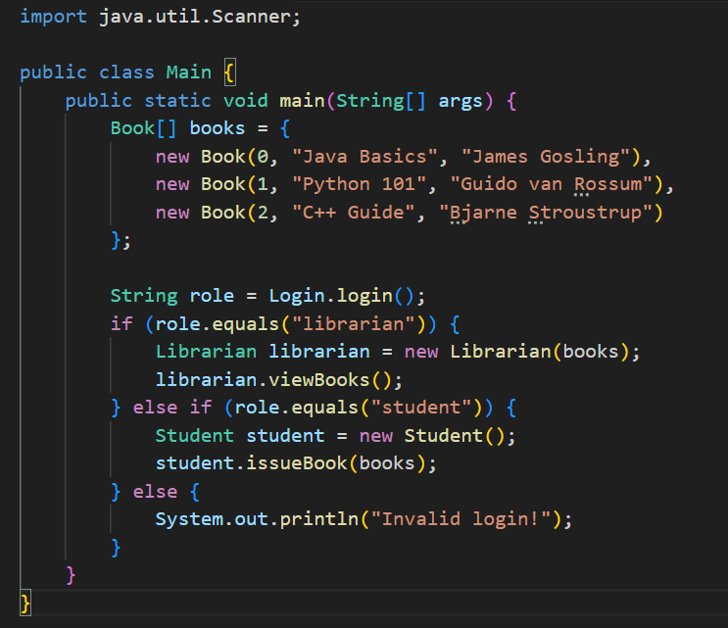
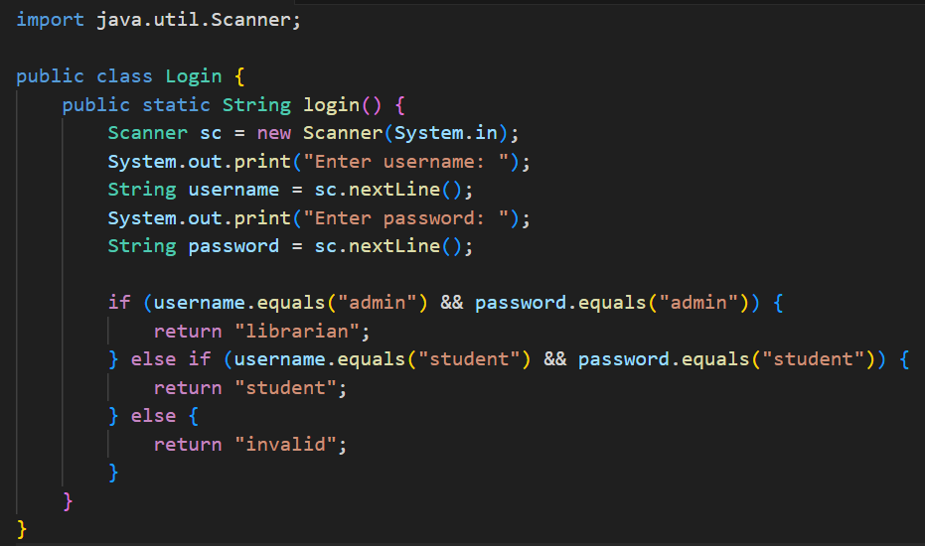
CLASSES OVERVIEW
Public Class Main 2) Public Class Login

Slide 8
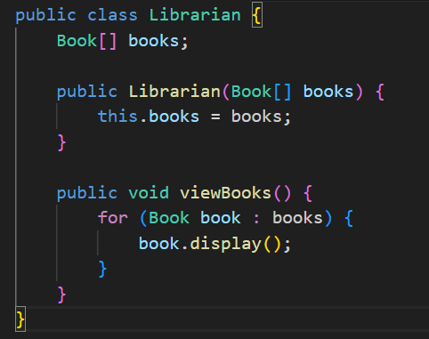
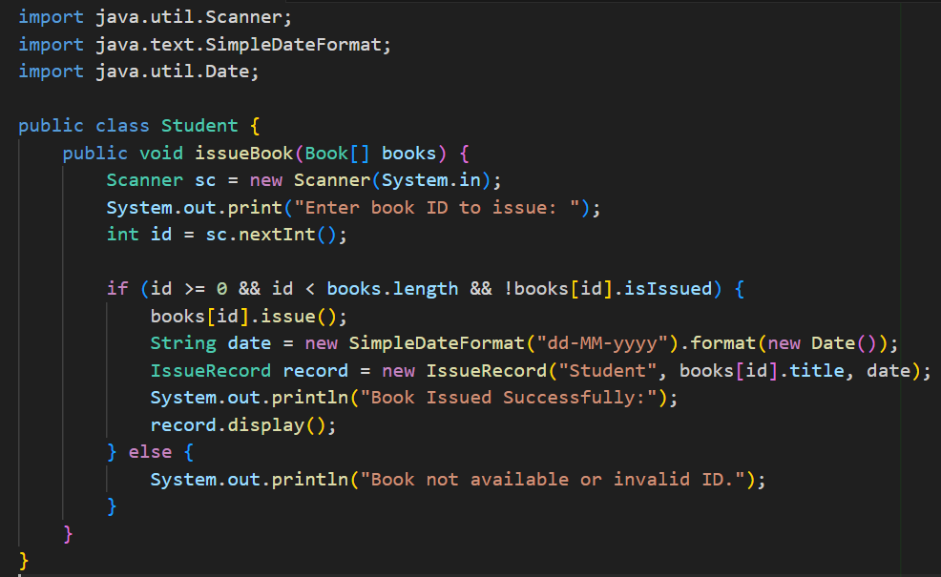
3)Public class librarian 4)Public Class Student

Slide 9
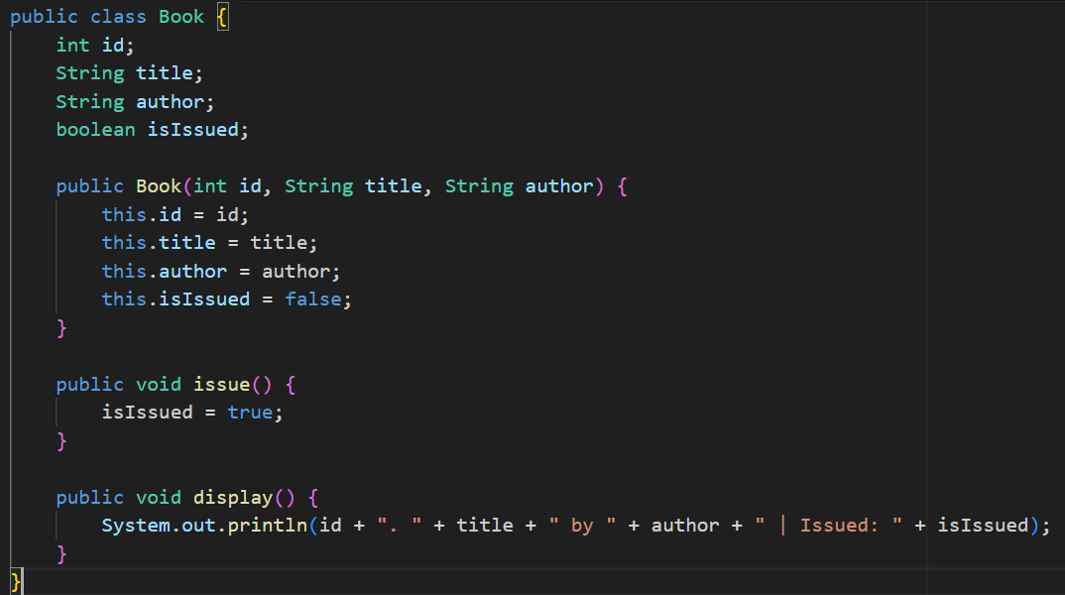
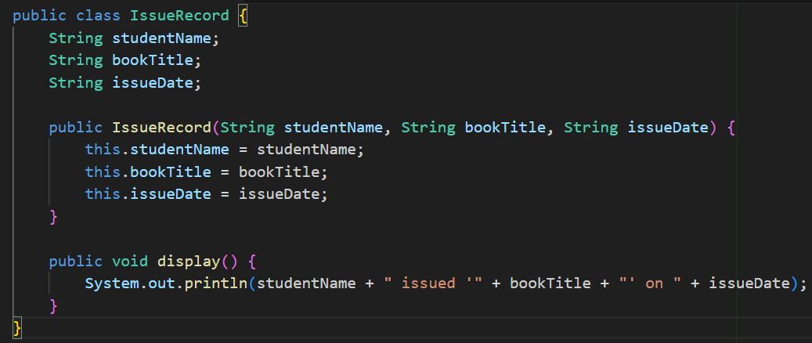
5)Public Class Book 6)Public Class IssueRecord

Slide 10

LOGIN INTERFACE
Login Screen
Valid inputs:
Librarian: admin(username) and admin (password)
Student: student(username) and student(password)
Invalids: Any other credentials

Slide 11
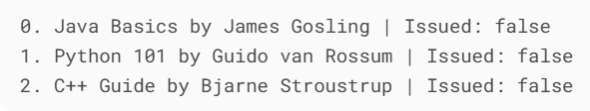

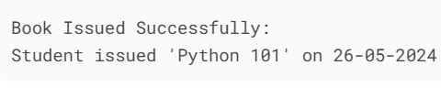
Librarian Flow (After Login)
If login as librarian(admin) the program automatically all books
Student Flow (After Login)
If logged in as a student, you’ll be prompted to issue a book:

Slide 12
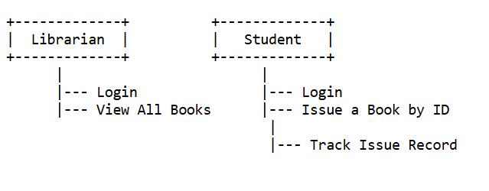
USE CASE DIAGRAM
A use case diagram is a
specific type of UML
diagram used to model
the interactions between
user and a system

Slide 13
BENEFITS AND LIMITATION
BENIFITS
Simple and Easy to Understand
Role-Based Access
Automated Issue Tracking
Immediate Feedback
LIMITATION
No Persistent Data Storage
Limited Functionality
No Input Validation

